Slide 1

AI system personalizes software interfaces in real time using user behavior and feedback
24-25J-296

Slide 2
Introduction
Modern software design emphasizes personalization to enhance user engagement and accessibility.
Most UIs are static and fail to adapt to individual user behaviors and preferences.
ReactiveWeb: A Chrome extension that dynamically personalizes Medium website UIs using AI-driven summarization, behavioral analysis, and accessibility enhancements.
Focus on improving user experience for both normal and visually impaired users.

Slide 3

Problem Statement
Static UIs do not cater to diverse user preferences, behaviors, or accessibility needs.
Existing systems (e.g., SummarizeBot, Flipboard, BeLine Reader) lack real-time AI-driven adjustments.
Pain points identified:
Lack of real-time UI adaptation.
Insufficient accessibility features for visually impaired users.
Limited customization options for content summarization and UI layout.

Slide 4

Research Gap
Existing systems focus on static personalization or single features (e.g., summarization or accessibility).
No system integrates AI-driven summarization, real-time UI adaptation, and accessibility enhancements in one tool.

Slide 5

Why Medium Platform?
Conducted an online survey with 50 Medium article readers to understand user preferences and pain points.
Survey revealed that 73% of respondents found the idea of a personalized UI extension useful.
Medium hosts a wide variety of articles on diverse topics.
Long-Form Content.
Engaged User Base.

Slide 6

Main Objective
To enhance the reading experience on Medium for both normal and visually impaired users.
To provide AI-driven summarization and UI personalization.
To offer real-time accessibility features for visually impaired users (e.g., color contrast, text size adjustments).

Slide 7

Sub Objectives
Enable AI-Based Summarization with UI Personalization
Allow users to choose summary formats (bullet points, short, long).
Customize UI based on user feedback.
Implement Dynamic UI Adaptation Based on User Behavior
Use AI to predict and modify UI dynamically based on scrolling and zooming behavior.
Enhance UI Personalization for Visually Impaired Users
Provide customizable UI settings for color-blind and short-sighted users.
Integrate accessibility feedback into the behavioral adaptation system.

Slide 8
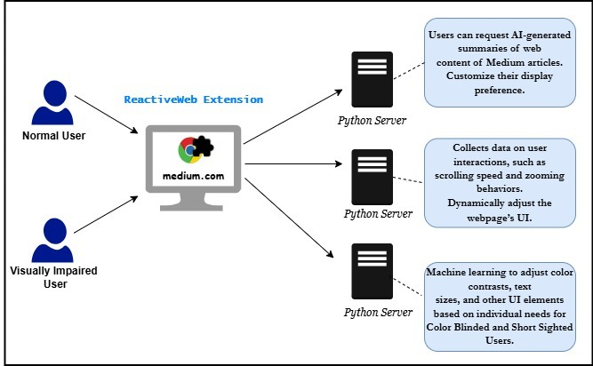
System Overview Diagram

Slide 9
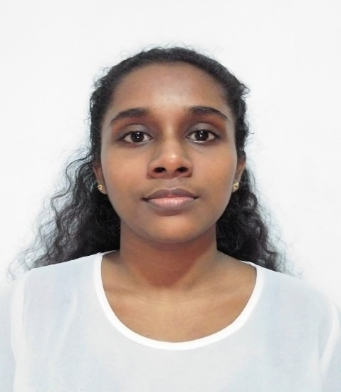
IT21324406 | Silva H.S.N
Software Engineering
IT21324406 | Silva H.S.N | 24-25J-296

Slide 10
Content-Based Summarization with UI Personalization Through User Feedback
IT21324406 | Silva H.S.N | 24-25J-296

Slide 11

Challenges in Existing System
Static Summarization Tools
No Real-Time Adaptation
Limited Accessibility
Lack of User Feedback Integration
Inflexible UI
IT21324406 | Silva H.S.N | 24-25J-296

Slide 12
System Solution
AI-Driven Summarization for Medium platform
UI Personalization and Dynamic Adaptation
Accessibility Integration
User-Centric Design
IT21324406 | Silva H.S.N | 24-25J-296

Slide 13
Tools and Methods
AI Model - OpenAI API (Large Language Model)
Backend Development - Python
API Integration: Fast API (Python web framework)
User Feedback Mechanism
IT21324406 | Silva H.S.N | 24-25J-296

Slide 14
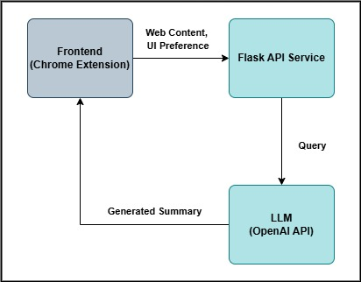
Feature Diagram
IT21324406 | Silva H.S.N | 24-25J-296

Slide 15
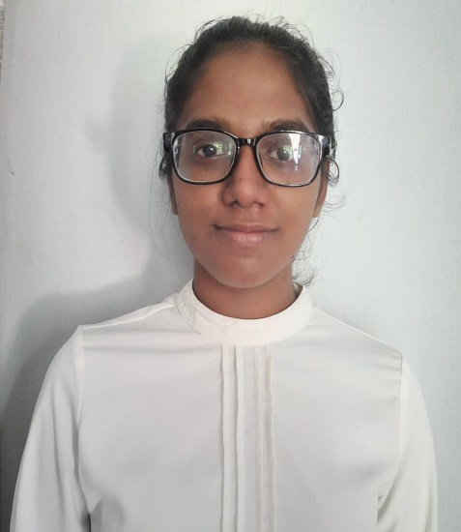
IT21215360 | Rosa M.D
Software Engineering
IT21215360 | Rosa M.D | 24-25J-296

Slide 16
Software User Interface Personalization through User Behavior and User Feedback
IT21215360 | Rosa M.D | 24-25J-296

Slide 17
Challenges in Existing System
Systems struggle with personalization using limited initial user data.​
Real-time adaptability is difficult.​
IT21215360 | Rosa M.D | 24-25J-296

Slide 18
System Solution
Tracks User Behavior:​
* Zoom level.​
* Scrolling Behavior. * Font Size.
Dynamic Adjustments:​
*Applies preferences live.​
*Updates interface instantly.​
IT21215360 | Rosa M.D | 24-25J-296

Slide 19
Tools and Methods
Reinforcement Learning (Q-Learning)
Probabilistic AI Model (Bayesian Network)
Neural Network (Deep Learning)
Flask API Handling
IT21215360 | Rosa M.D | 24-25J-296

Slide 20
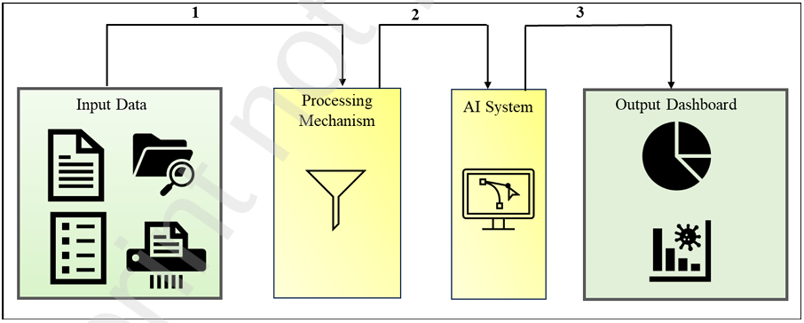
Feature Diagram
IT21215360 | Rosa M.D | 24-25J-296

Slide 21

IT17117210 | Sandun Geemal H.L
Information Technology
IT17117210 | Sandun Geemal H.L | 24-25J-296

Slide 22
Improving Browsing Experience for Users with Visual Disabilities
IT17117210 | Sandun Geemal H.L | 24-25J-296

Slide 23
Challenges in Existing System
Limited Adaptability
UI settings are often fixed and do not dynamically adjust based on user
Do not support color blind users and short slightness users at once
Cannot use across multiple platforms
IT17117210 | Sandun Geemal H.L | 24-25J-296​

Slide 24
System Solution
Machine Learning-Based Theme Recommendation
Accessibility-First Design
Interactive Accessibility Tests
IT17117210 | Sandun Geemal H.L | 24-25J-296​
IT17117210 | Sandun Geemal H.L | 24-25J-296

Slide 25
Tools and Methods
Machine Learning XGBoost
Flask Framework
User Test
Backend Development Python
IT17117210 | Sandun Geemal H.L | 24-25J-296

Slide 26
Feature Diagram
Chrome Extension
Interactive Accessibility Tests
Machine Learning Model – Theme Prediction
Apply Theme
IT17117210 | Sandun Geemal H.L | 24-25J-296

Slide 27
Thank You

